Slide 1
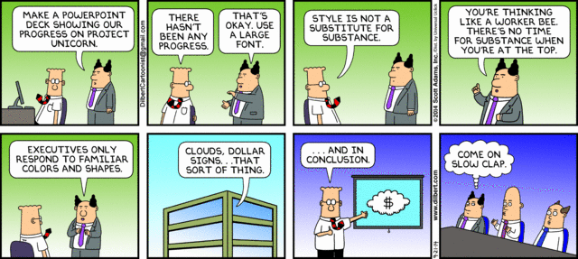

Slide 2

DCMB BioComputing BootCamp Day 3, Lecture 3: Data Exploration and Visualization in R
Armand Bankhead
bankhead@umich.edu
8/22/2018

Slide 3

Now What?
Scenario:
You understand the fundamentals of R
You’ve read your data into an R data frame
During this session we will talk about
Basic data summarization
Visualize data with plots

Slide 4
Overview
Summarizing Data in R
Creating plots in R Using ggplot2

Slide 5
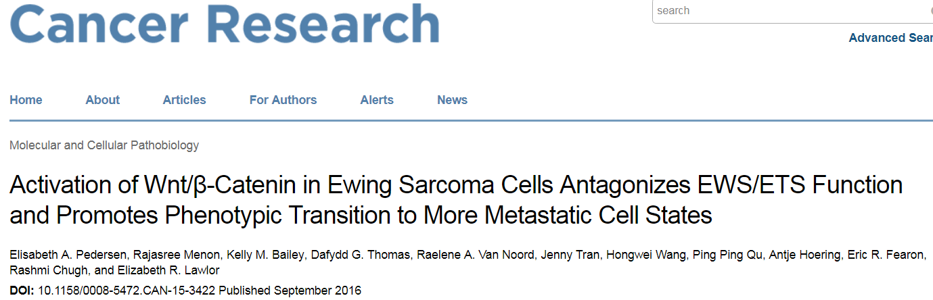
Example Data Set:
Ewing’s sarcoma: rare bone and soft tissue cancer occurring in children and teenagers
70-80% survival
In vitro CHLA25-7TGP ES cells stimulated to over-express WNT3A
RNA-Seq profiling used to quantify gene expression
Download pedersenLog2RPKM20180817.txt and pedersenLog2_matrixRPKM20180817.txt from the Day3 course website.
Notes:
0.3 cases per million in children
4.6 cases per million in adolescents

Slide 6
Exercise: Write a Script to Read Pedersen Gene Expression Data into a Data Frame
Do it Yourself!
Download both Pedersen data files
Use setwd() to move to the data file folder
options(stringsAsFactors=F)
Use the read.delim() function to read in “pedersenLog2RPKM20180817.txt” file into a data frame called “data1”
Use the head() and dim() function to find out about the structure of this data file
How many rows? What are the columns?

Slide 7
Quickly Calculate Simple Statistics
Do it Yourself!
R has many built in statistical functions that use fast vector and matrix operations
No need to write a for loop, sum, and then divide by n
Just provide a vector of data to the mean() function:
> mean(data1$log2RPKM)
With one line of code you have take the mean of 97,000 values!
Exercise: Use mean(), median(), max(), min(), summary() functions on the Pedersen data

Slide 8
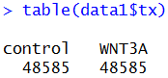
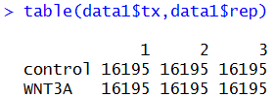
Using the table() Function
When exploring new datasets it is often useful to count the number of values
table() can be used to build a contingency table of the counts of each value
For one column:
For multiple columns:

Slide 9
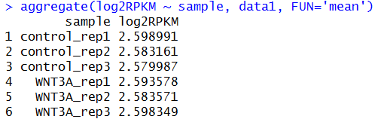
Using the aggregate() Function
Do it Yourself!
Often times we want to perform a function on subsets of our data
example question: What is the mean expression for each sample?
aggregate() splits data into subsets, computes summary statistics for each and returns the result
aggregate() takes several arguments:
formula
input data
summary statistic
formula format: y ~ x1
y is a numeric value
x1 is a grouping variable
possible to specify multiple groups as x1 + x2 + …
Exercise: Use aggregate() to calculate the maximum log2RPKM value per sample.

Slide 10

Data Visualization Allows Researchers to Visually Present Data
Minard’s 1869 diagram of Napoleonic France’s invasion of Russia
Line width indicates size of army
Color indicates army’s course to and from Russia

Slide 11
Data Visualization Allows Researchers to Visually Present Data
Data visualizations should:
Show the data
Avoid distorting the data
Present many numbers in a small space
Make large data sets coherent
Serve a reasonably clear purpose
Be closely integrated with the statistical and verbal descriptions of a data set
https://en.wikipedia.org/wiki/Data_visualization

Slide 12
R Base Graphics Versus ggplot2
R comes with “base graphics” built in to support commonly used data visualizations
Today we will focus on using an alternative data visualization framework called ggplot2
ggplot2 is an external package that must be downloaded, installed, and loaded with the library command
A common practice is to use ggplot2 to construct publication quality graphs but still use base graphics to quickly visualize data
https://flowingdata.com/2016/03/22/comparing-ggplot2-and-r-base-graphics/

Slide 13
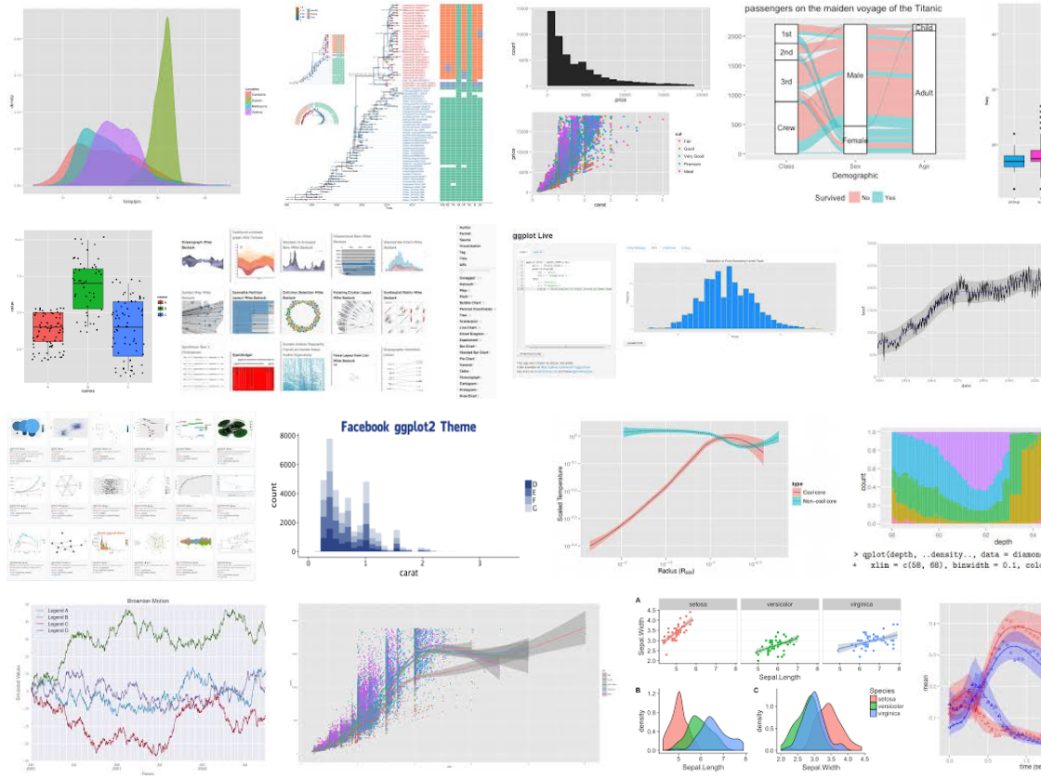
ggplot2
ggplot2 is an R data visualization package created by Hadley Wickham
One of the most popular R packages
Breaks up graphs construction into additive functions called layers
ggplot2 documentation and cheat sheet: https://www.rdocumentation.org/packages/ggplot2/versions/3.0.0

Slide 14
Creating a Visualization with ggplot2
options(stringsAsFactors=F)
library(ggplot2)
inFile = ‘data.txt'
data1 = read.delim(inFile)
ggplot(data1,aes(x = log2RPKM)) +
geom_histogram()
ggsave(‘histogram.png')
ggplot2 visualization function calls consist of several basic components:
ggplot()
geom_XXX()
optional layers
ggsave()
Multiple function calls are combined together using “layers”
aes(thetic) functions are used to map input data to plot features (e.g. x axis, y axis, colors)
input data frame
aesthetic

Slide 15
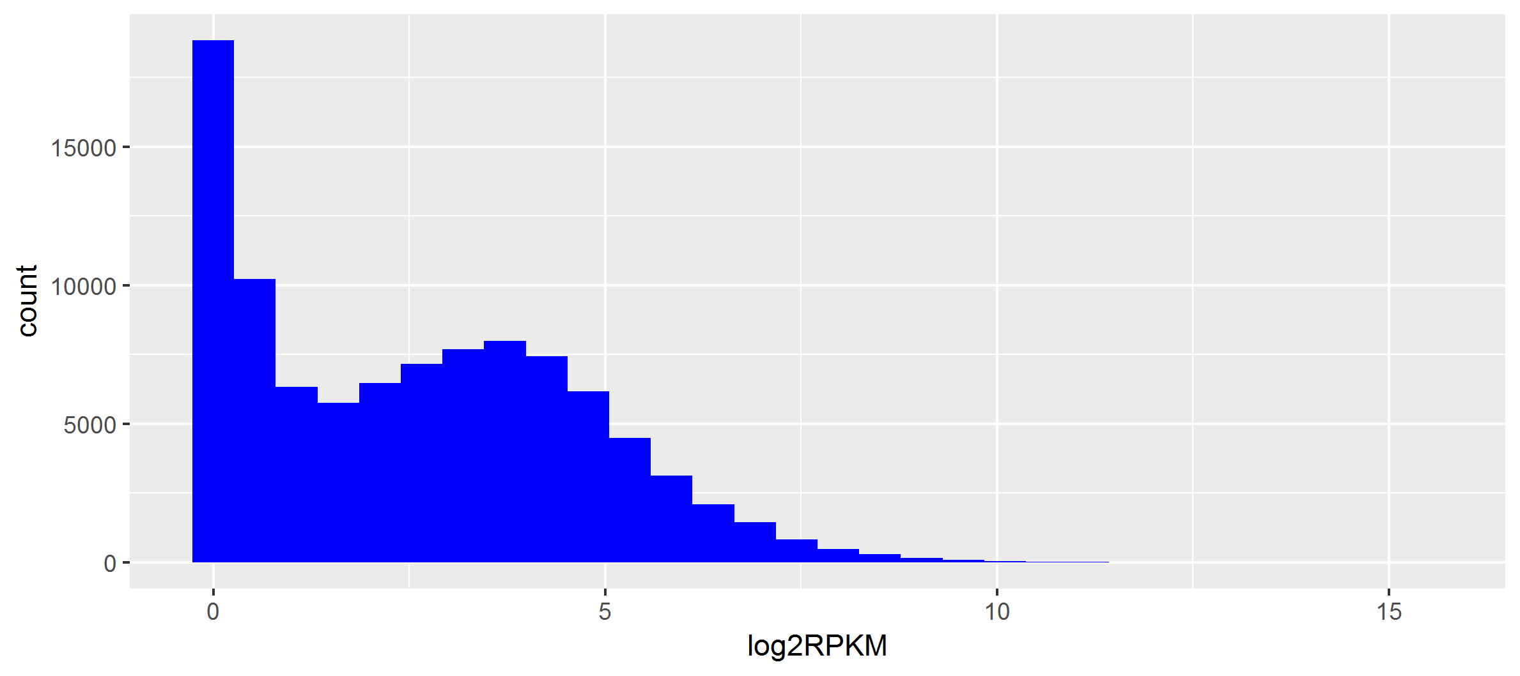
Visualizing Data Using Histograms
histogram: a type of bar graph visualization in which data measurements are counted based on value
For discrete measures it shows the frequency of values in each category
For continuous measure it shows the frequency of values occurring in small intervals covering the whole range
Pedersen Gene Expression

Slide 16
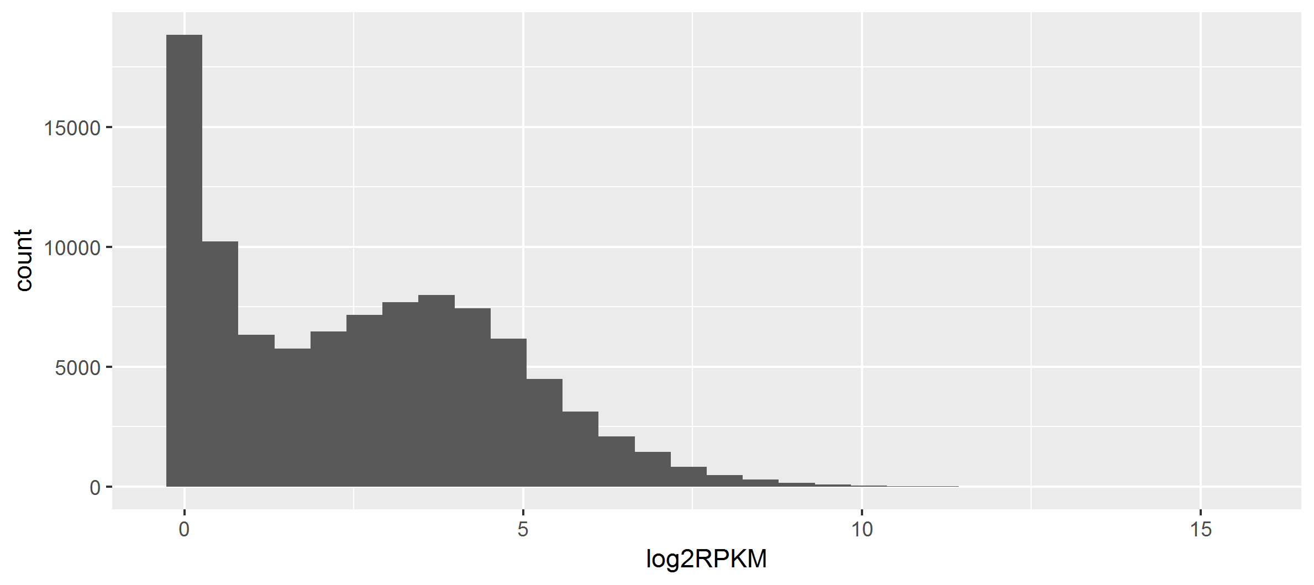
How to Create a Basic Histogram Using ggplot2
options(stringsAsFactors=F)
library(ggplot2)
inFile1 = 'pedersenLog2RPKM20180817.txt'
data1 = read.delim(inFile1)
ggplot(data1,aes(x = log2RPKM)) +
geom_histogram()
ggsave('histogram1.png')

Slide 17
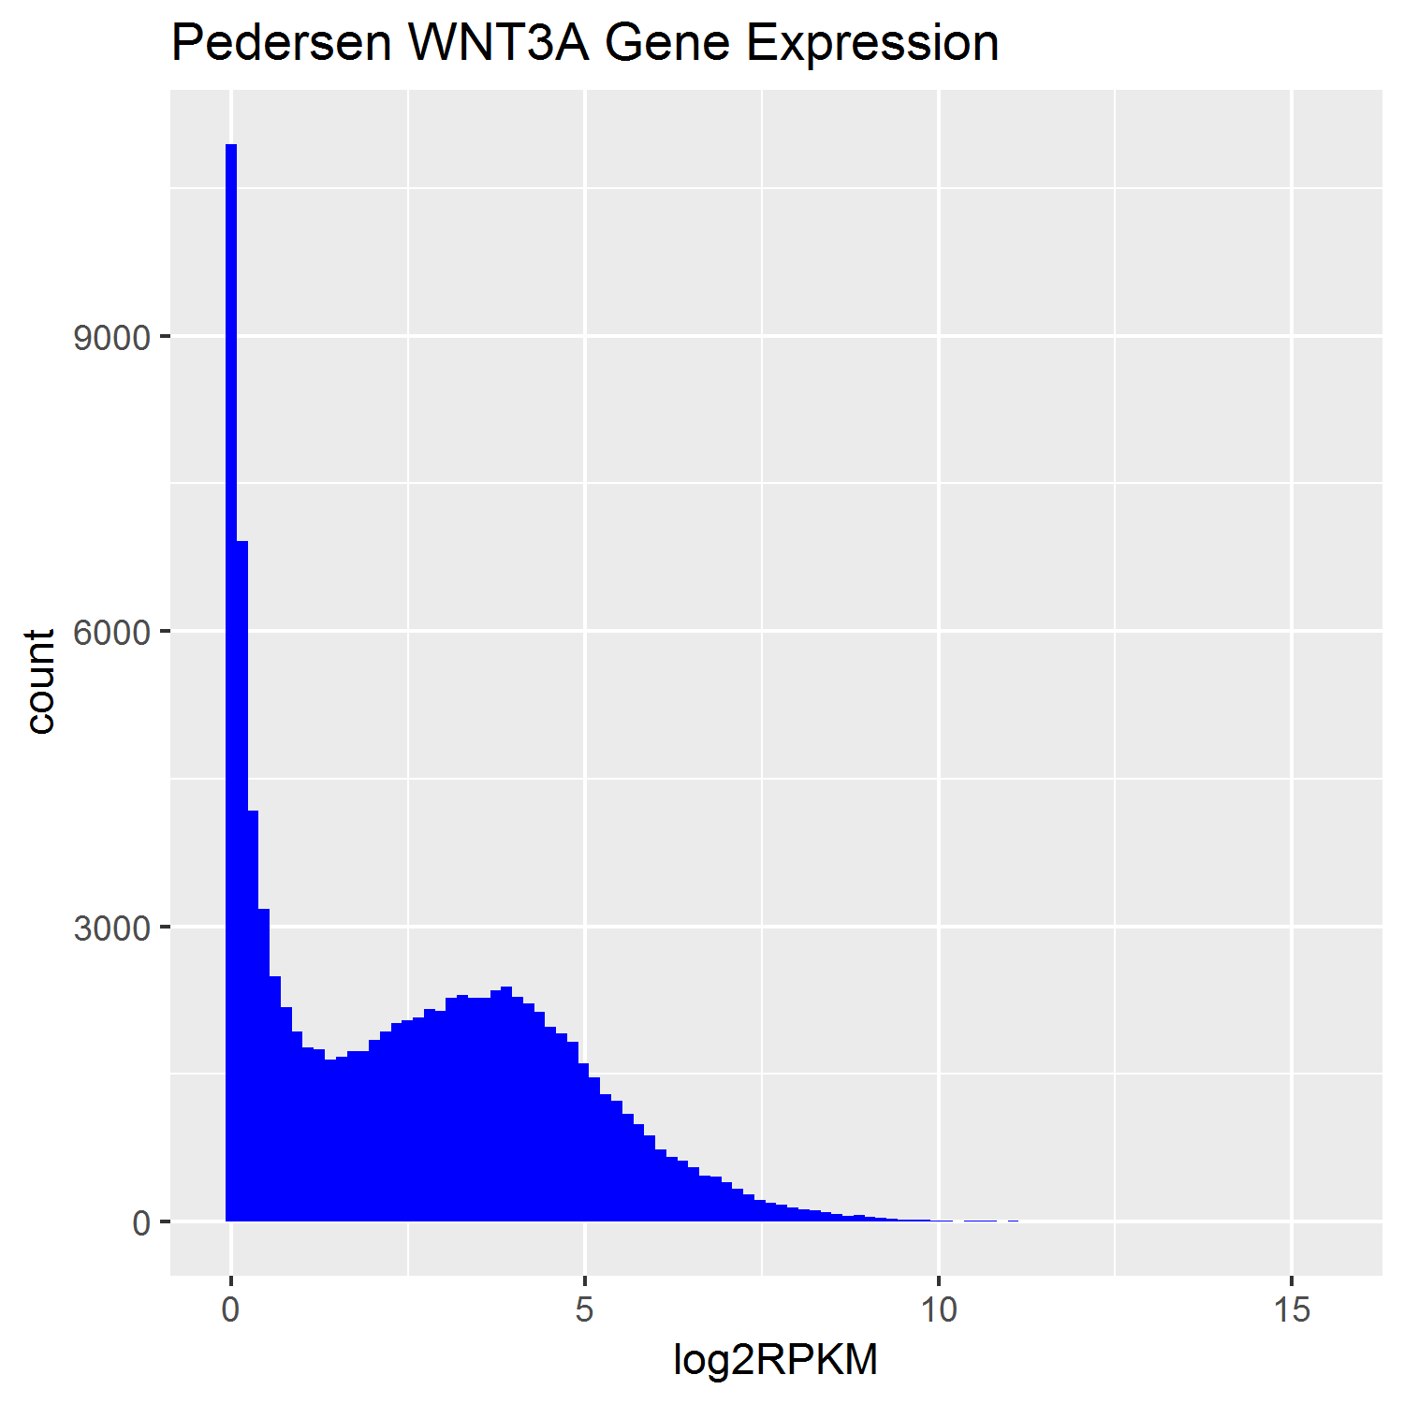
Exercise: Create a histogram using the code from the previous page and update your visualization to:
Do it Yourself!
Change the color
HINT: ?geom_histogram
HINT: fill = “blue”
Set the image width and height to be 5 inches
HINT: ?ggsave
HINT: height = 5
Adjust the number of bins to 100
Add a title
HINT: ?labs

Slide 18
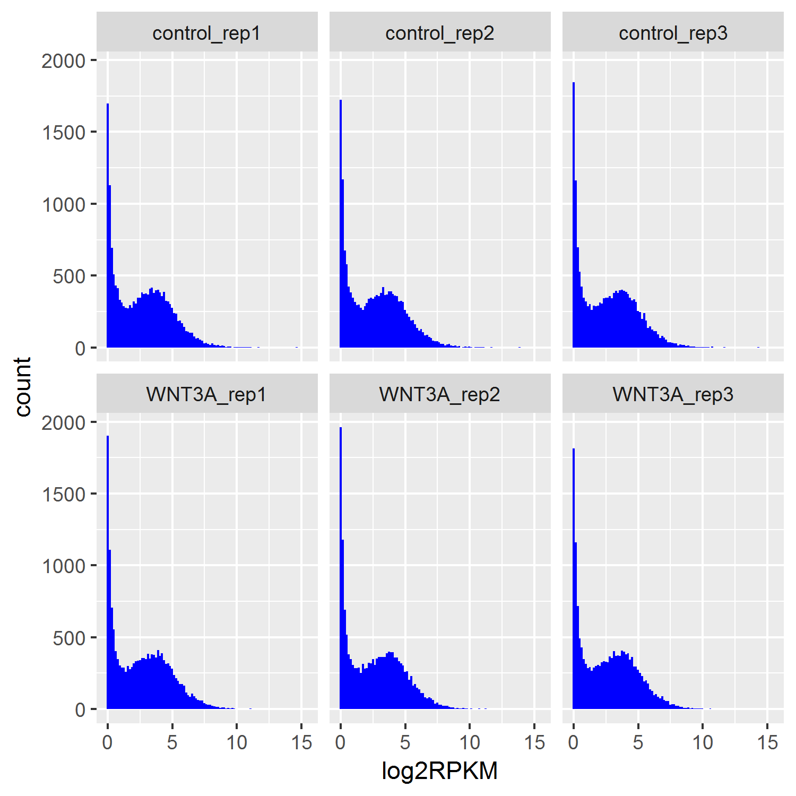
Exercise: Update your histogram visualization to facet on sample
Do it Yourself!
Create Sub-plots Using Facets
Sub-plots can easily be created using facet layers:
facet_wrap()
facet_grid()
Add a facet_wrap() layer
HINT: + facet_wrap(~sample)

Slide 19
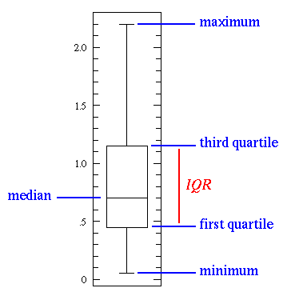
Visualizing Data Using Boxplots
boxplot: graphically represents data distributions using quartiles
box-and-whisker plot: includes boxplots with lines extending from boxes to indicate variability outside the upper and lower quartiles
Why it is useful?
Summarize the main characteristics of the data: Mean/median, quartile, spread, symmetry and outliers.
Efficient – less complicated than histogram
Allows us to represent multiple data distributions in the same graph

Slide 20
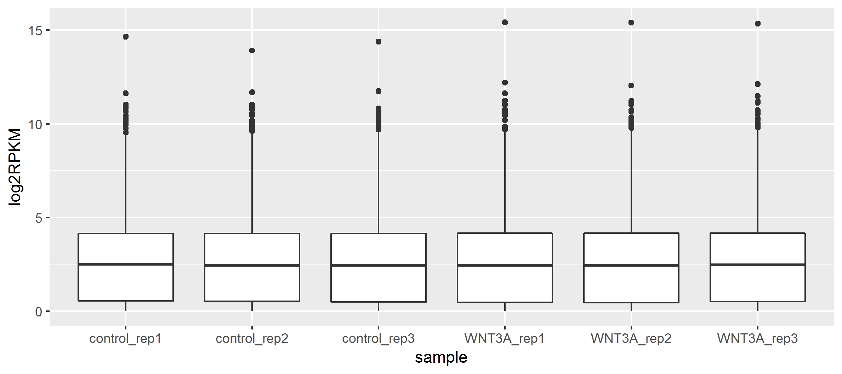
How to Create a Boxplot Using ggplot2
options(stringsAsFactors=F)
library(ggplot2)
inFile1 = 'pedersenLog2RPKM20180817.txt'
data1 = read.delim(inFile1)
ggplot(data1,aes(x = log2RPKM)) +
geom_boxplot()
ggsave('boxplot1.png')

Slide 21
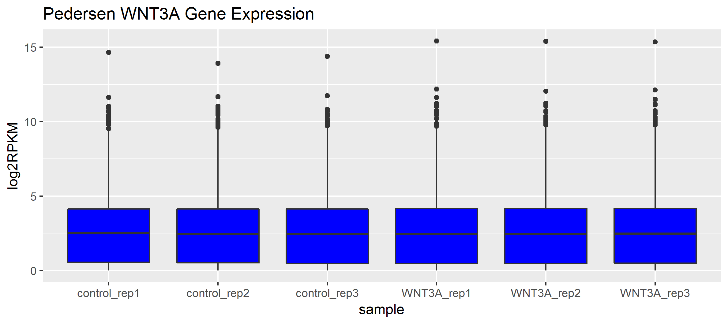
Exercise: Create a boxplot using the code from the previous page and update your visualization to:
Do it Yourself!
Change the fill color
HINT: fill = 'blue'
Add a title
HINT: ?labs
If time: Try creating a violin plot using geom_violin()

Slide 22
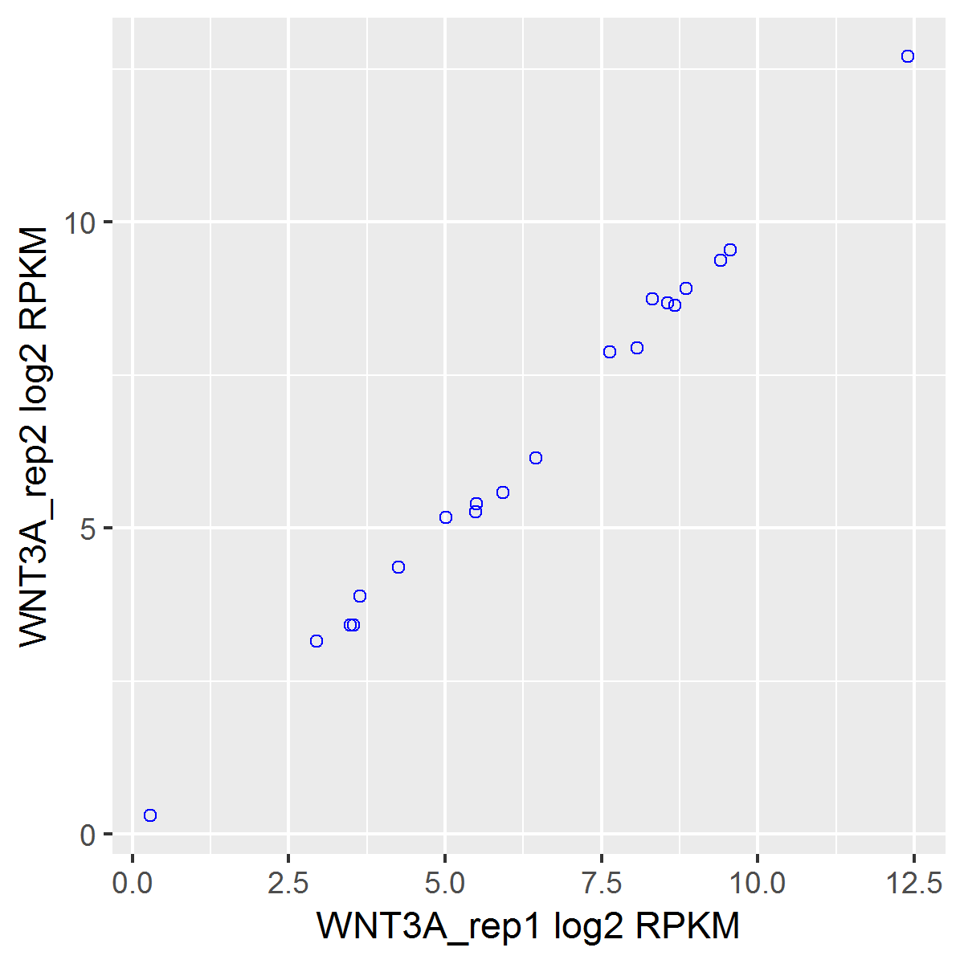
Visualizing Data Using Scatter Plots
Scatter Plots are visualizations that display two data values for the same measurement
example: two sample replicates expression values for each gene
Data points that are not on the diagonal indicate disagreement
We expect strong agreement between sample replicates

Slide 23
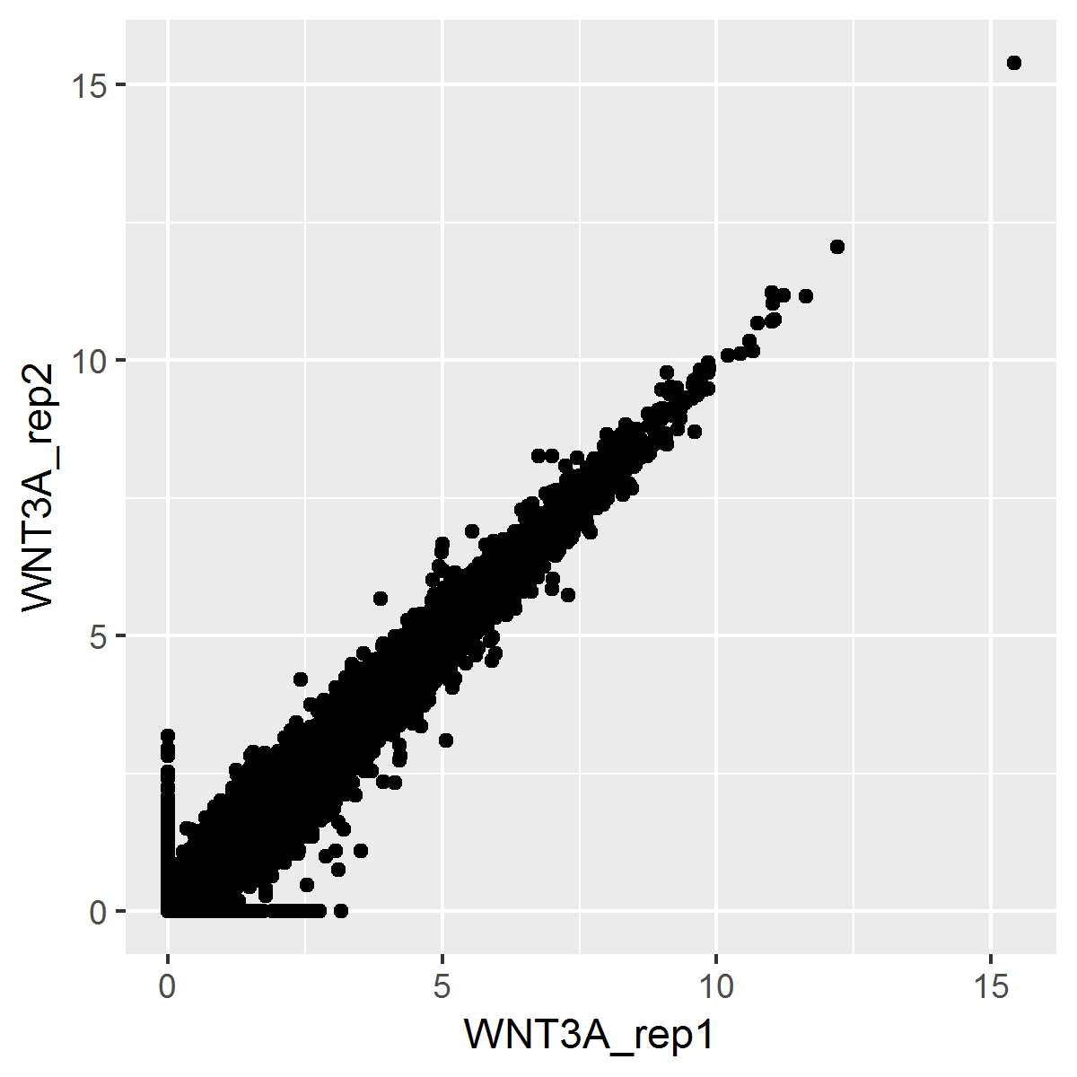
How to Create a Scatter Plot Using ggplot2
options(stringsAsFactors=F)
library(ggplot2)
inFile2 = 'pedersenLog2RPKM_matrix20180817.txt'
data2 = read.delim(inFile2)
ggplot(data2,aes(x = WNT3A_rep1, y = WNT3A_rep2)) +
geom_point()
ggsave('scatter2.png')

Slide 24
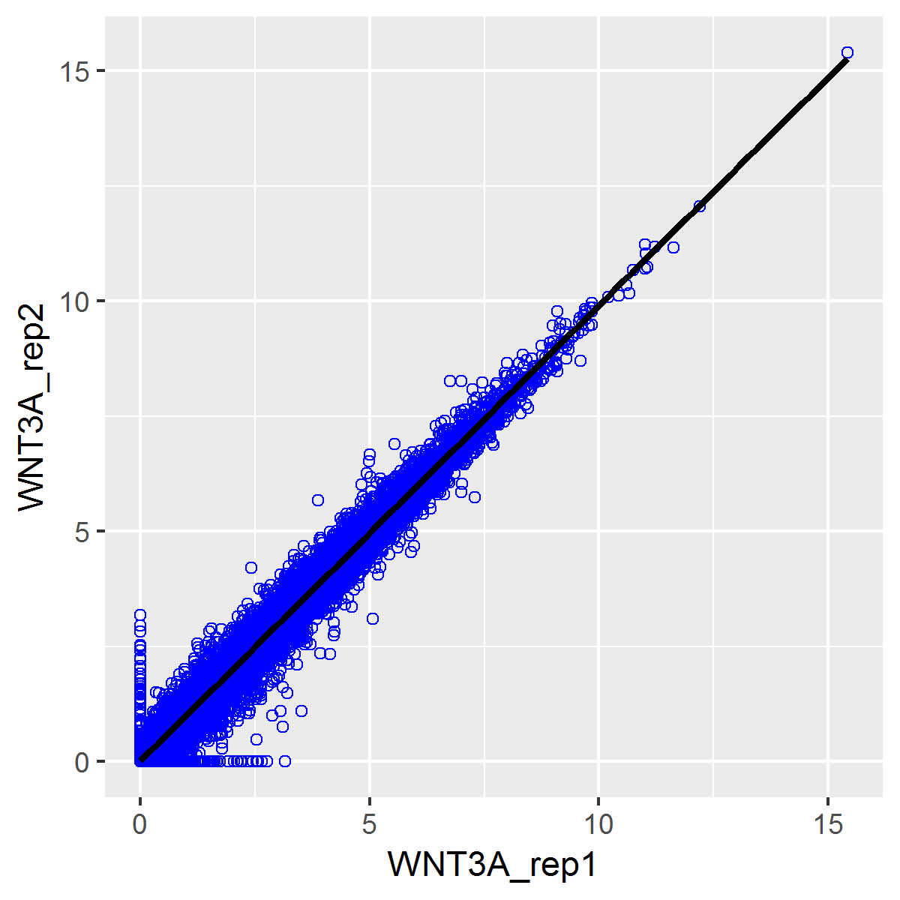
Exercise: Create a boxplot using the code from the previous page and update your visualization to:
Do it Yourself!
Change the color and shape of scatter plot points
HINT: color = 'blue'
HINT: shape = 1
Add a black linear regression line using a geom_smooth layer
HINT: geom_smooth(method = lm)

Slide 25
ggplot2
We covered ~3 types of ggplot2 visualizations today
There are many more!
Check out https://www.r-graph-gallery.com/portfolio/ggplot2-package/ for further inspiration

Slide 26
References
Gentleman, Robert. R Programming for Bioinformatics. CRC Press, 2009.
Slides Partially Sourced from Jacob Kitzman and Barry Grant

Slide 27
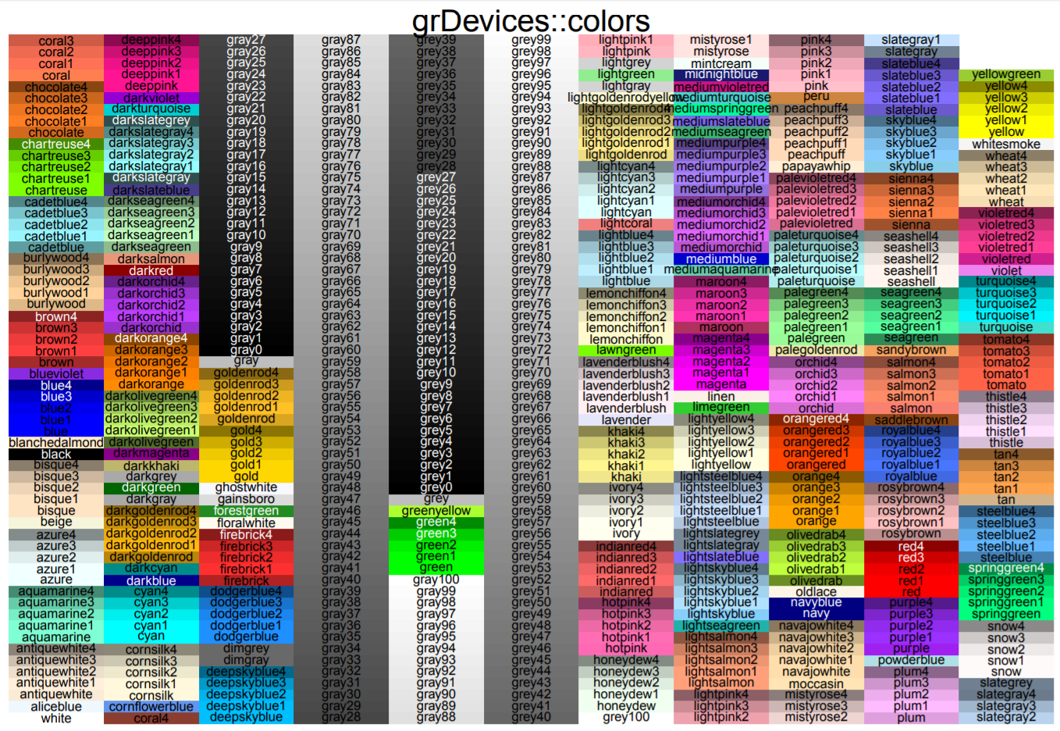
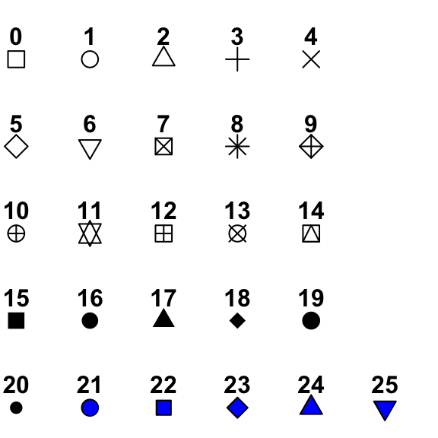
R Graphics Colors
R Graphics Shapes
http://bc.bojanorama.pl/wp-content/uploads/2013/04/rcolorsheet.pdf
http://www.sthda.com/english/wiki/r-plot-pch-symbols-the-different-point-shapes-available-in-r

